Slide 1
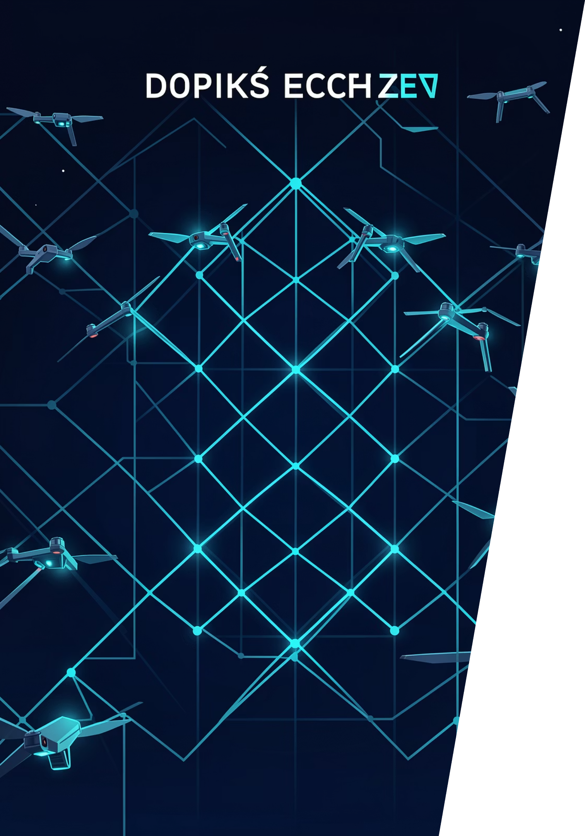
Subtask 1: Static Formation from Grid to Handwritten Name
Presented by: [Devi Chikovani]
Course: [Numerical Programming]
Instructor: [Ramaz Botchorishvili]

Slide 2

OVERVIEW
Project Requirements, Inputs, and Outputs
Inputs for Simulation
Handwritten image (PNG, JPG)
Number of drones (N)
Initial drone positions (grid formation)
Outputs from Simulation
Collision-free drone trajectories
Smooth drone movement visualization
Formation of the target image

Slide 3
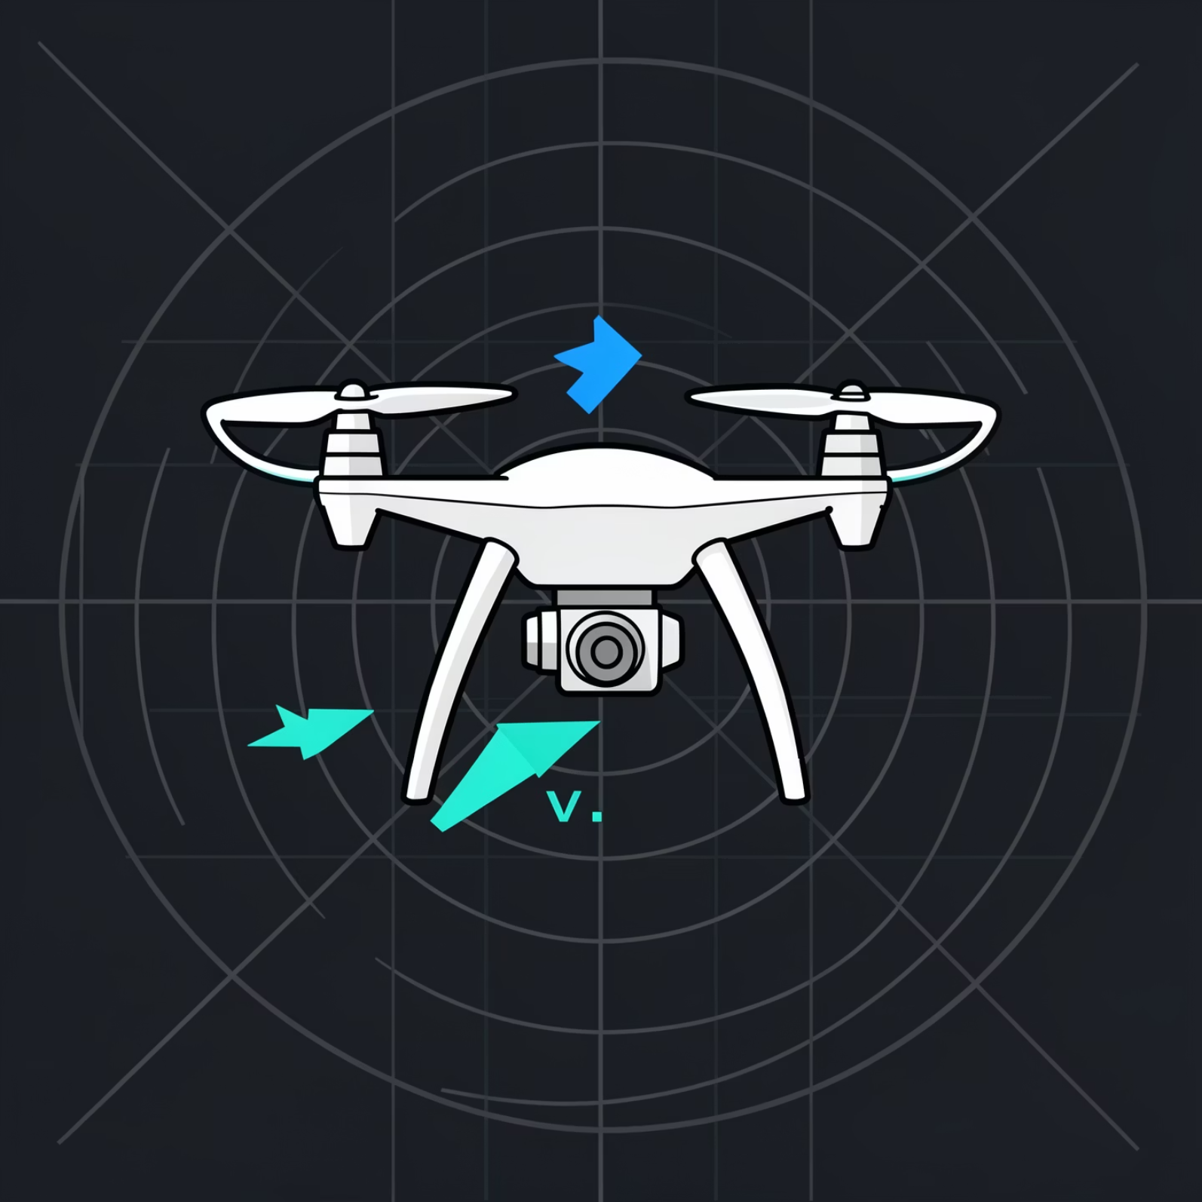
FORMULATION
Problem Formulation: An Initial Value Problem (IVP)
The dynamic behavior of each drone is defined by its initial state (position and velocity) and a set of governing equations. This makes the system an Initial Value Problem.
State Variables per Drone (i)
Position: x_i(t) \in \mathbb{R}^2 (2D coordinates)
Velocity: v_i(t) \in \mathbb{R}^2 (2D vector)
The collective state of the system is the concatenation of all individual drone states.

Slide 4
DYNAMICS
Governing Equations: Core IVP Dynamics
The motion of each drone is governed by a system of ordinary differential equations (ODEs), balancing attractive forces, repulsive forces, and damping.
Symbol Definitions
k_p: Proportional gain (attraction)
k_d: Damping gain (friction)
f_{\mathrm{rep}}: Repulsion force from drone j
v_{\max}: Maximum allowable speed
x_i: Position vector of drone i
v_i: Velocity vector of drone i
T_i: Target position for drone i
m: Mass of drone i

Slide 5
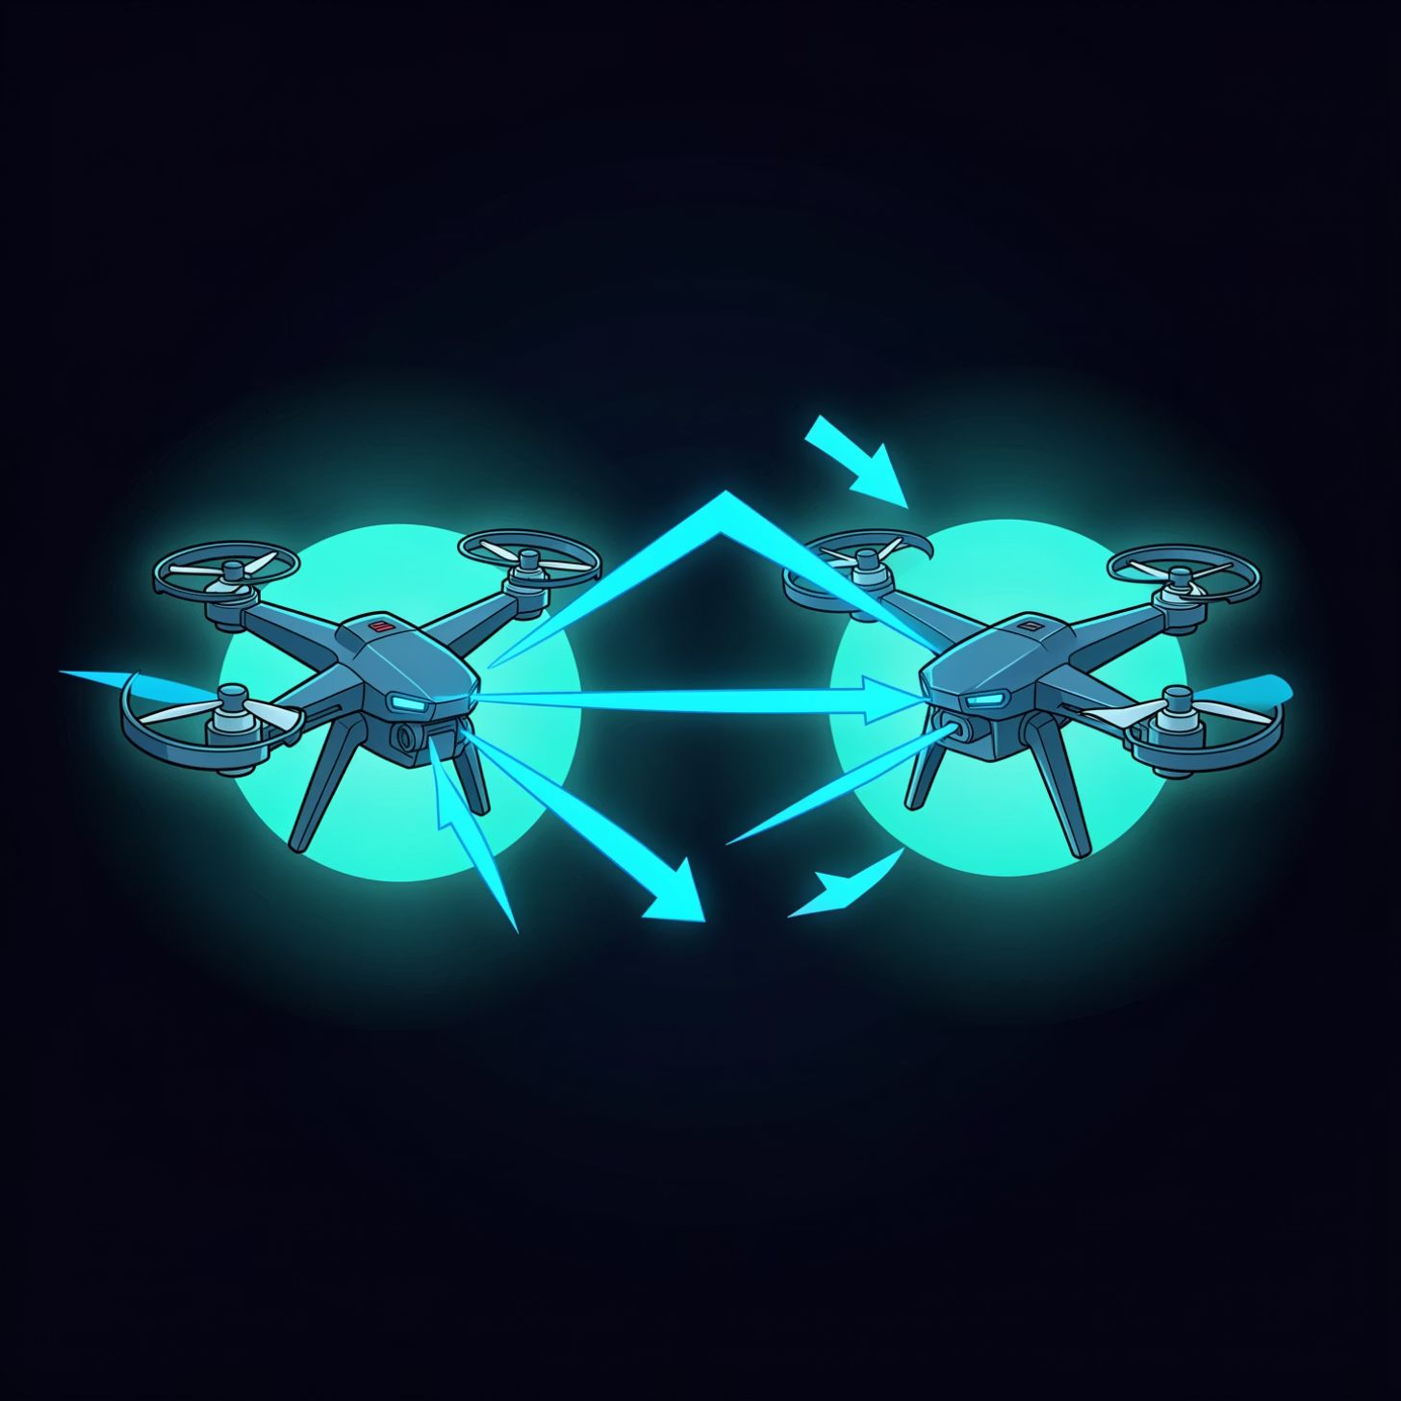

SAFETY
Collision Avoidance Mechanism
The repulsive force f_{\mathrm{rep}} is inversely proportional to the cube of the distance, ensuring a strong divergence as drones get closer.
k_{\mathrm{rep}}: Repulsion gain (strength)
R_{\mathrm{safe}}: Minimum safe distance between drones
This model ensures that drones maintain a minimum separation distance, preventing physical overlap while maintaining smooth trajectories.

Slide 6



TARGET PREP
Target Extraction from Handwritten Image
To transform a handwritten image into a drone formation, the image must first be processed to extract target points.
1. Grayscale Conversion
2. Edge Detection
3. Uniform Sampling
Convert the input image to grayscale to simplify pixel intensity analysis.
Apply the Canny edge detection algorithm to identify prominent contours.
Uniformly sample N target points \{T_i\} \subset \mathcal{E} from the detected edges \mathcal{E}.
This process generates a set of discrete target points that define the desired formation for the drones.

Slide 7
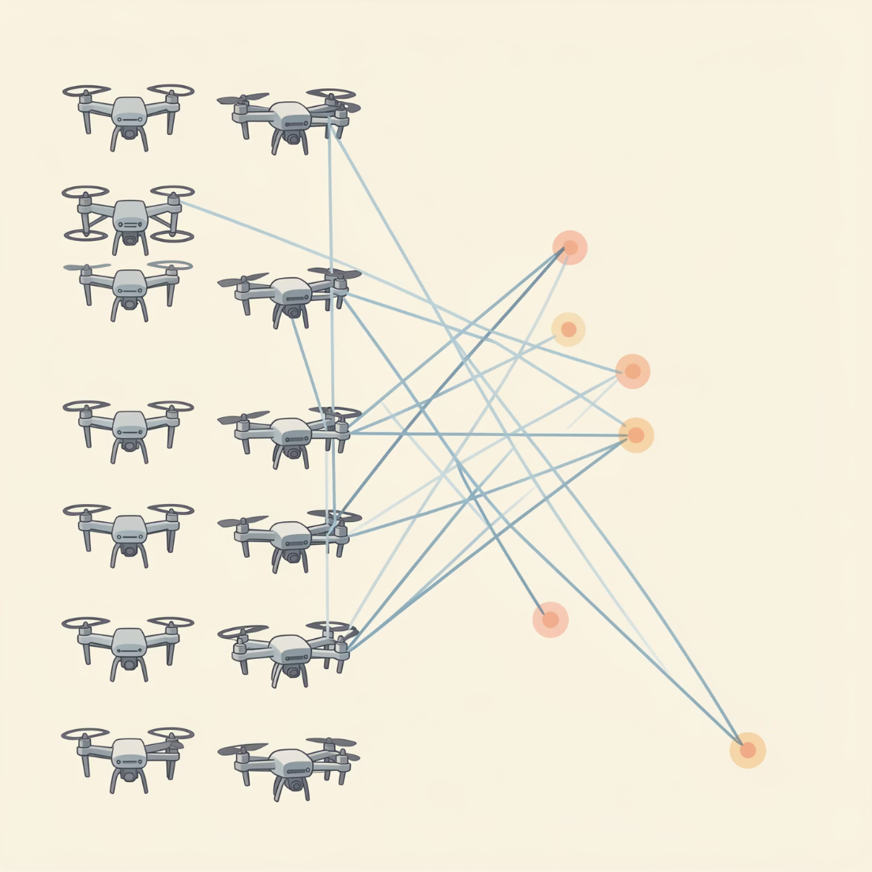
OPTIMIZATION
Drone-to-Target Assignment
Optimal assignment of drones to target points minimizes initial travel distance, ensuring efficient formation.
Cost Function
The cost D_{ij} for assigning drone i to target j is defined as the Euclidean distance:
Assignment Algorithm
Greedy One-to-One Matching: Drones are iteratively assigned to the closest available target point.
Optional: Hungarian Algorithm: For global optimality, the Hungarian algorithm can be used, though it is computationally more intensive for large N.

Slide 8

IMPLEMENTATION
Numerical Integration Method: Runge-Kutta 4 (RK4)
The system's continuous dynamics are approximated using a fixed-step RK4 integration scheme.
The RK4 method provides a balance between accuracy and computational efficiency for solving ODEs.
RK4 Update Equation
Simulation Parameters
For a generic ODE \dot{y} = f(t,y), the RK4 update is:
\Delta t (Fixed Timestep): Constant interval for integration, typically small (e.g., 0.01s).
Steps Per Frame: Multiple \Delta t steps are executed between each rendered frame for visual smoothness.
Where k_1, k_2, k_3, k_4 are intermediate slope evaluations.

Slide 9

ANALYSIS
Stability & Convergence Analysis
Understanding the system's dynamics is crucial for stable and oscillation-free drone behavior.
Linearized Single Drone Dynamics
This second-order linear ODE describes the motion of a single drone under attractive and damping forces.
Damping Ratio
\zeta > 1 (Overdamped): The system returns to equilibrium without oscillation, which is desirable for smooth drone movement.
\zeta = 1 (Critically Damped): Fastest return to equilibrium without oscillation.
\zeta < 1 (Underdamped): The system oscillates around equilibrium, which should be avoided for drone formations.
Careful selection of k_d, k_p, and m ensures an overdamped response for optimal visual smoothness.

Slide 10

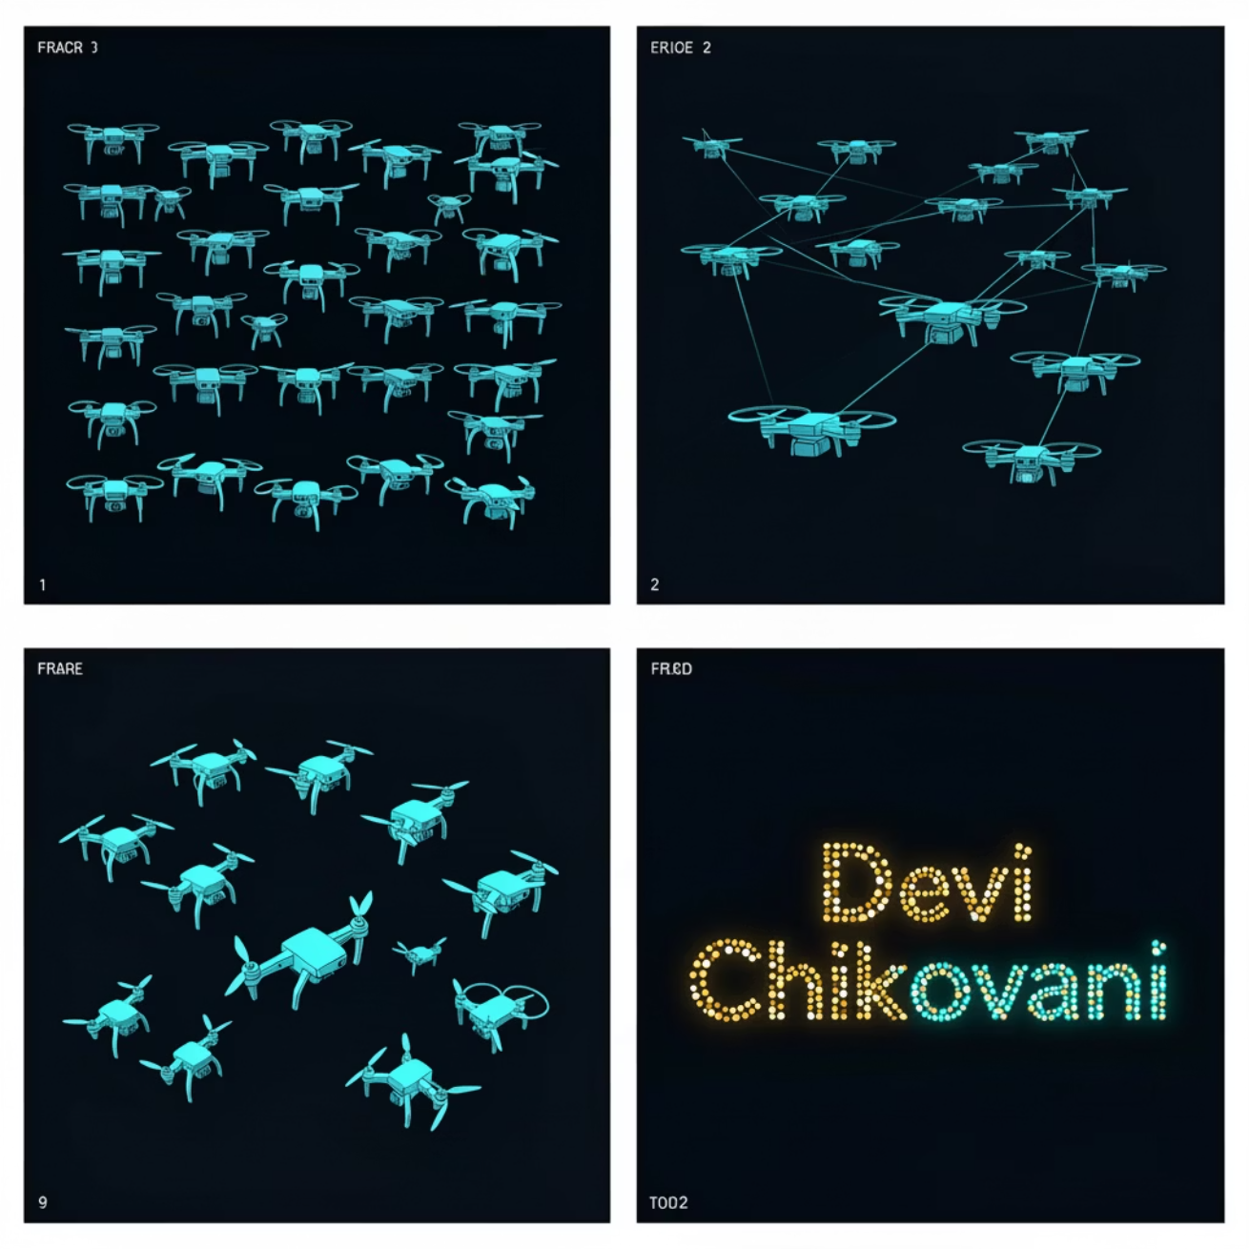
VALIDATION
Validation Metrics & Test Cases
To evaluate the performance of the simulation, key metrics and specific test scenarios are used.
Performance Metrics
Visualizations
Mean Tracking Error: e(t)=\frac1N\sum\|x_i-T_i\|Measures how closely drones follow their assigned targets.
Minimum Distance: d_{\min}(t)\ge R_{\mathrm{safe}}Ensures collision avoidance is maintained throughout the simulation.
Maximum Speed: \le v_{\max}Confirms drones operate within physical limits.

